Slide 1
The Intersection of Library Science and User Experience
A presentation to LIS650: Passive Site Architecture and Design
Palmer School of Library & Information Science
Prof. Thomas Krichel
Dawn Bovasso, Content Strategist @ Razorfish
Lynn Leitte, Sr. Content Strategist @ Razorfish
February 8, 2009

Slide 2
Agenda
Why We’re Here
About Us
What Is User Experience?
Roles Within User Experience
How Are UX/Content Strategy Related to Librarianship?
UX/Content Strategy Deliverables
What We Think
Questions

Slide 3
Why We’re Here
Aspiring librarians are introduced to career paths such as public libraries, academic libraries, and archives. Subject area specialists may go into medical or corporate librarianship. How many library programs are talking about web design or web development a skill set or career path? Do many librarians know that a career web development is even an option?
Librarianship is a relevant – and important – skill set for a career in User Experience.
What careers can you have outside of libraries? What are the job titles? Where are they?

Slide 4
About Us
Lynn Leitte, Sr. Content Strategist
Library Area: Archives manuscripts processing & curatorial
What Libraries: Minnesota Historical Society, Minnesota State Archives, Charles Babbage Institute (Univ. of MN special collection)
Tech: low level HTML & XHTML, XML and some RDF
UX Strengths: classification, taxonomy, organizational schemes, keywords, and information architecture
UX Projects: knowledge bases, content heavy sites, e-commerce
Dawn Bovasso, Content Strategist
Library Area: Rare books, cataloging, reference, digital libraries
What Libraries: Boston Public Library, Quincy College Library, Dedham Public Library
Tech: XML (METS/MODS/RDF), content management systems
UX Strengths: information architecture, taxonomy, strategy
UX Projects: e-commerce, portals, non-profits

Slide 5
How We Got Here
After careers in librarianship, Lynn Leitte and Dawn Bovasso transferred their skills to the corporate world of metadata and web design. They are both currently Content Strategists at Razorfish, an interactive web design agency with a heavy emphasis on user experience.
Both have found that their background in library science is in high demand and greatly utilized. In this talk, they will provide an overview about careers in UX relevant to library science, discuss transferrable skills, and answer questions about how to get on a UX career path.

Slide 6
What Is User Experience (UX)?
Simply: “user-centered design.” Focuses on the user, not on what the owner of the site wants to push
The total subjective experience of the user of a Web site: positive, negative or in between
Is it easy to use, attractive and appropriate? Does it meet user needs?

Slide 7
Roles Within the User Experience Practice
User Experience Associate (UXA)
This entry-level position is meant to introduce recent graduates to the industry. They may try all positions, much like an internship, to see which track to follow
Information Architect (IA)
Defines the structural design and interaction for websites, intranets, and online communities – similar to the way architects create blueprints for houses
IAs create sketches, diagrams, or prototypes for websites that determine the best practices for layout, as well as suggest interactions

Slide 8
Roles within the User Experience Practice
User Research (UR)
Conducting customer research, field observations, and secondary research to identify user roles, the characteristics, needs
Content Strategy (CS)
Organizing and managing the content of a website. Requires expertise on nomenclature, taxonomy, navigation, editorial and copywriting, as well as content migration and content management systems

Slide 9
About Content Strategy
Content Strategy is an integral part of the UX design process
Figuring out how to use content to help people find content, achieve business goals, communicate strategic messaging, facilitate transactions and sustain branded experiences
Content Strategists work closely with IAs, UXDs, Strategists, Functional Analysts, Business Analysts, and clients

Slide 10
How are UX /Content Strategy Related to Librarianship?
Traditional library-centric skills such as classification, data organization, provenance, and reference services translate into UX
Library area | UX area
MARC Cataloging | User access points, standards
Classification and subject headings | Metadata schema, semantic technologies, user access points, navigation, site nomenclature, SEO
Provenance | Pre-existing conditions, business goals
Reference desk & reference interview | Stakeholder interviews, user research
Patron types & interests | Personas, user-groups, demographics
Acquisition & appraisal | Content Audit, content inventory, gap analysis, nomenclature

Slide 11
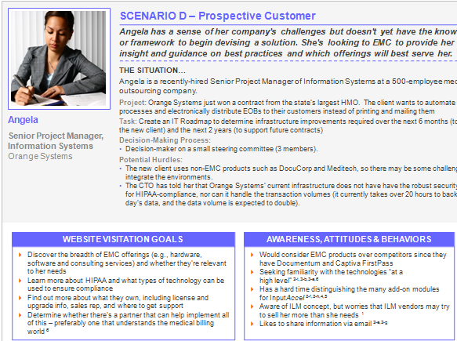
UX Deliverables
Persona Development
Archetypes of website visitors who that have similar needs, goals, attitudes, and behaviors
They help test decisions around information architecture, content strategy, tone of voice, visual design and interface design
How Library Skills Connect
General librarianship: Similar to identifying types of patrons
Archives: Reference services and the skill of being attentive to what people do and ask while researching

Slide 12
UX Deliverables
Content Audit
What works/what doesn’t
Content (or lack there of) that makes users leave the site
What is becoming passé/what is the newest trend
How Library Skills Connect
General librarianship: Collection assessment
Archives: Acquisition and accessioning skills; knowing what is valuable and pertinent to a content set or audience

Slide 13
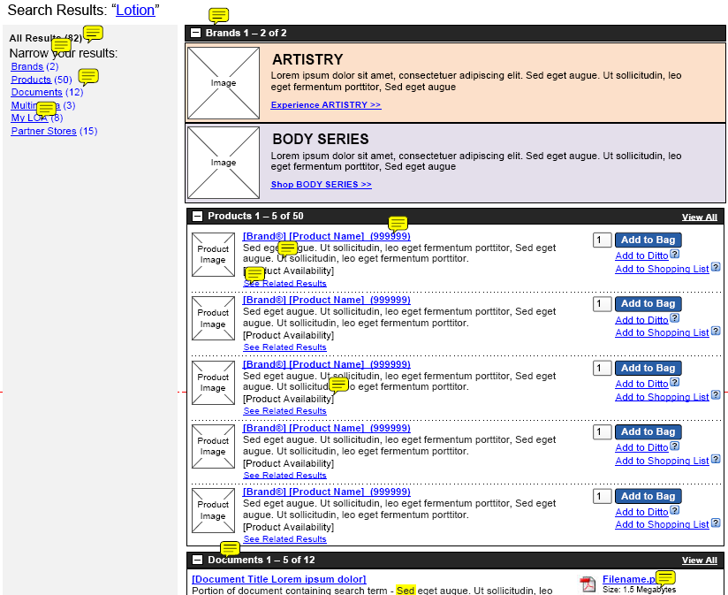
UX Deliverables
Wireframe Review
Review of content elements (e.g., copy, tools, related links)
How much goes on the page?
How Library Skills Connect
General librarianship: Flow of physical library space
Archives: The flow and relationship of the topics and content presented together. Biggest difference: this is visual as much as text
Slide 13

Slide 14
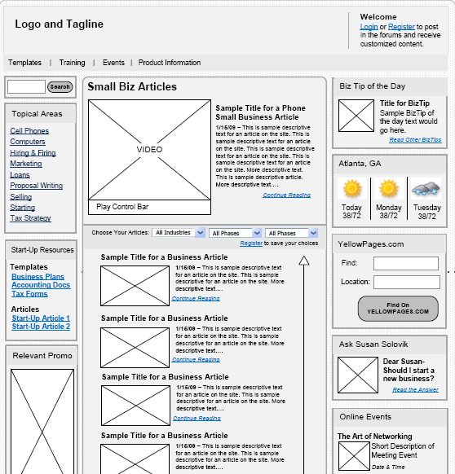
UX Deliverables
Wireframe Review
What’s most important and how do things related to each other?
Navigation and nomenclature
How Library Skills Connect
General librarianship: Flow of physical library space
Archives: The flow and relationship of the topics and content presented together. Biggest difference: this is visual as much as text

Slide 15
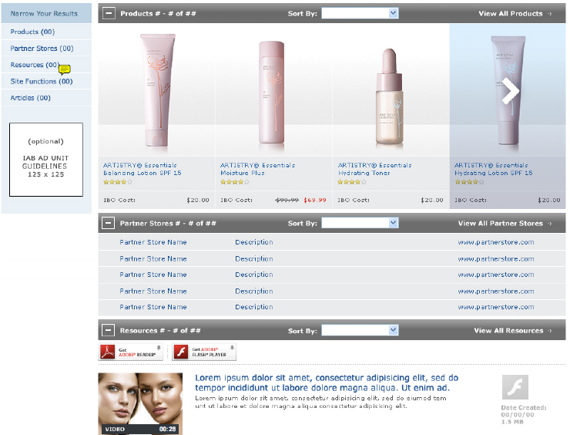
UX Deliverables
Design Comp Review
Evaluate the creative design execution against the usability and content delivery questions
Check for consistency between the wireframes and the comps
Does the content support the overall artistic message? (and vice versa)
How Library Skills Connect
General librarianship: What does the patron look for when surfing/searching?
Archives: Not much cross-over between archives work and creative comps.

Slide 16
UX Deliverables
Navigation
Decide the format (hierarchical or categorical)
Decide the function (faceted, assisted, etc.)
Decide the nomenclature
How Library Skills Connect
General librarianship: Similar to determining LC Subject Headings
Archives: Manuscripts processing and finding aid creation very closely replicates this kind of work and required thinking. You are questioning what items belong together, are subordinate to other groups, and make sense together

Slide 17
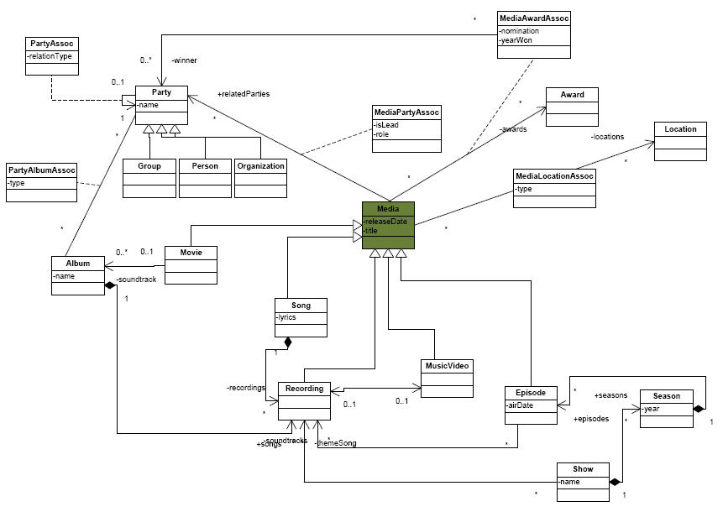
UX Deliverables
Metadata Schema
Lists, tables, and graphs to describe and define the metadata
How does the metadata function? What are the rules?
How is the metadata connected?
How Library Skills Connect
General librarianship: Developing metadata for digital libraries
Archives: User access points and original cataloging – thinking about the different ways a piece can be described or what it contains

Slide 18
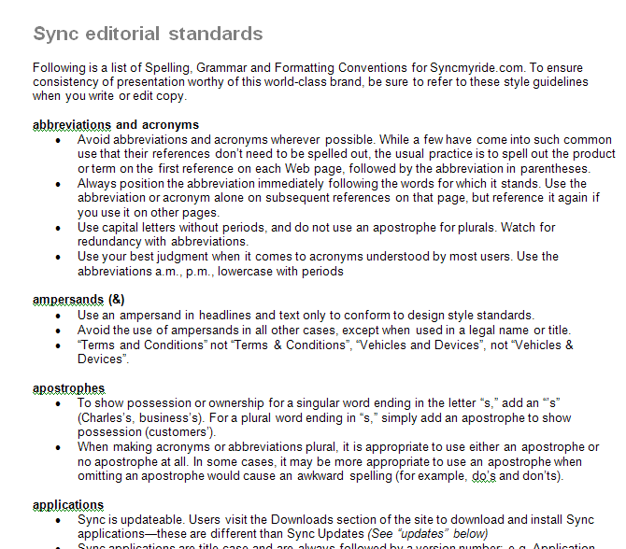
UX Deliverables
Editorial Style Guide
Documentation for content creators and editors for the site
Defines grammatical and punctuation rules for the site
Often addresses language use in the site – tone & voice
How Library Skills Connect
General librarianship: None?
Archives: Standards for original cataloging and finding aid production will serve you here. Most of this work is capturing examples of academic standards such as Chicago Manual of Style

Slide 19
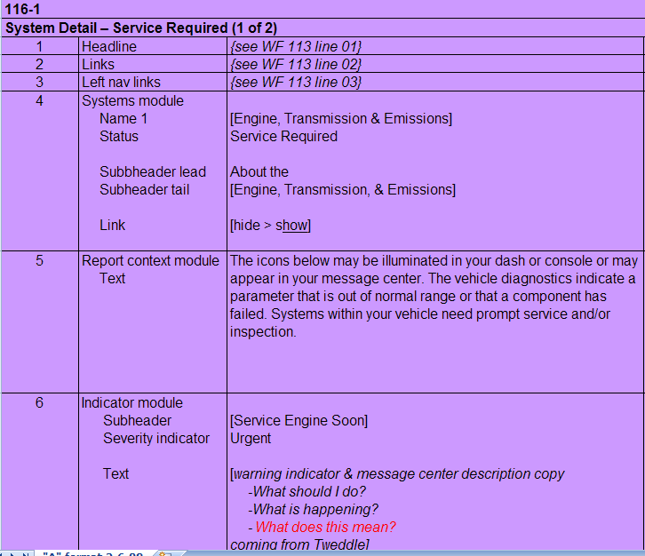
UX Deliverables
Content Matrix
Captures the content for each page of the site
Ties nomenclature & copy writing to the wireframes
Can become a tool to aid migration efforts by tracking content from the old site into the new site
How Library Skills Connect
General librarianship: General reference materials indexing
Archives: Finding aid production and processing tasks help you keep a lot of content and a lot of moving parts under control

Slide 20
What Do We Think: From Library to Corporate
What We Like, What We Miss
We love:
The broad range of skills we use:
Technology, creativity, organization, management
The pace, demand, and initiative
The pay
Collaborative teams
Bringing our skills to a place where they are needed and unique
We miss:
Primary materials
Patron interaction
Interest in existing standards for data
Academic endeavor
Regular hours
Slide 20

Slide 21
What Do We Think: From Library to Corporate
What You’ll Keep & What’s New
You’ll keep:
Taxonomy & classification
Organization skills
Serious thinking about how content of any type is interconnected
New:
Internet standards such as XML, CMS, and technology trends
Marketing and business initiatives are important to UX work
Visual thinking skills – you’ll be collaborating with people who sketch, draw, and think about visual cues
Presentations and public speaking – your work and analysis shared with teams, clients, peers, etc.

Slide 22
Time for Your Questions?
Questions about being a UXer?
Questions about UX or website design?

Slide 23
Resources
Books
Information Architecture for the World Wide Web, 2rd ed., by Louis Rosenfeld and Peter Morville
Design of Sites by Douglas van Duyne, et. al.
Web Navigation: Designing the User Experience by Jennifer Flemming
Humane Interface by Jeff Raskin
Blogs and websites
Boxes and Arrows http://boxesandarrows.com/
A List Apart http://www.alistapart.com/
Digital Web Magazine http://www.digital-web.com/
Brain Sparks – Jared Spool http://www.uie.com/brainsparks/author/jared/
Taxonomy Community of Practice http://finance.groups.yahoo.com/group/TaxoCoP/
Adaptive Path http://adaptivepath.com/
Slide 23

Slide 24
Resources
Where to look for UX Jobs
Razorfish
Sapient
HUGE
ICON
Publicis (or any major interactive agency)
Skills you should learn
Visio or OmniGraffle
PowerPoint – advanced (this isn’t a joke… agencies are crazy for it)
PhotoShop
Content management systems
Slide 24

Slide 25
Thank you
Lynn Leitte
Sr. Content Strategist
Razorfish
212.798.7361
lynn.leitte@razorfish.com
LinkedIn: Lynn Leitte
AIM: javabird919
Dawn Bovasso
Content Strategist
Razorfish
212.798.6767 dawn.bovasso@razorfish.com

